Slide 1

PROGRAMMING (Matrices)
Sunil Nadella
M.Sc.,M.Tech., M.Phil.,PGDCS.,(Ph.D)
Director & HOD
Associate Professor
PG Department Of Computer Science
Ideal College Of Arts & Sciences
Kakinada
http://sunilnadella.googlepages.com

Slide 2
Introduction
A Matrix is a vector with two additional attributes , the number of rows and number of columns.
Multidimensional vectors in R are called Arrays.
A two dimensional array is also called Matrix and is eligible for usual mathematical operations.
Matrix row and column subscripts begin with 1, so for instance the upper-left corner of the matrix a is denoted a[1,1]. The internal linear storage of a matrix is in column-major order, meaning that first all of column 1 is stored, then all of column 2, etc.
We use matrix() function to create a matrix

Slide 3
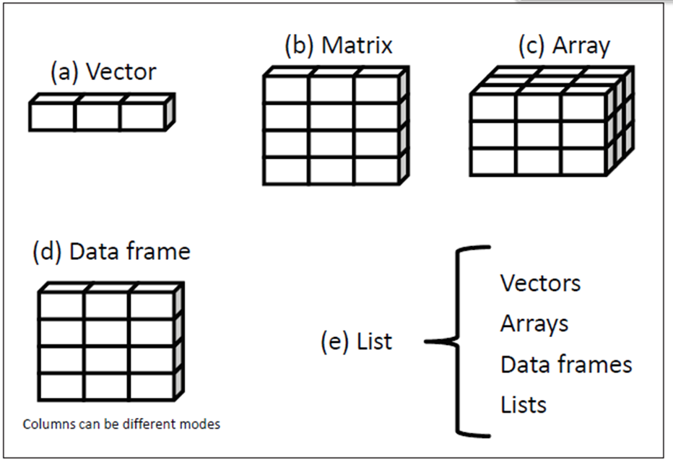
Data structures in R

Slide 4
Creation of Matrix
One way of creating a matrix
> m<-matrix(nrow=2,ncol=2)
> m[1,1]=12
> m[1,2]=24
> m[2,1]=21
> m[2,2]=42
> m
[,1] [,2]
[1,] 12 24
[2,] 21 42
>

Slide 5
Example 1
> matrix(c(12,23,34,45),nrow=2,ncol=2)
[,1] [,2]
[1, ]12 34
[2,] 23 45
>
Example 2
> matrix(c(12,23,34,45),nrow=1,ncol=4)
[,1] [,2] [,3] [,4]
[1,] 12 23 34 45
>
Example 3
> matrix(c(12,23,34,45),nrow=4,ncol=1)
[,1]
[1,] 12
[2,] 23
[3,] 34
[4,] 45
>

Slide 6
Example 4
> matrix(1:6, nrow=3)
[,1] [,2]
[1,] 1 4
[2,] 2 5
[3,] 3 6
>
Example 5
> #filling matrix by row major
> matrix(seq(1,6), nrow=3, byrow=TRUE)
[,1] [,2]
[1,] 1 2
[2,] 3 4
[3,] 5 6
>

Slide 7
Example 6
> mat1<-matrix(seq(1,12),nrow=3,ncol=4)
> mat1
[,1] [,2] [,3] [,4]
[1,] 1 4 7 10
[2,] 2 5 8 11
[3,] 3 6 9 12
>
Example 7
> mat<-matrix(seq(1,12),nrow=3,ncol=4)
> mat
[,1] [,2] [,3] [,4]
[1,] 1 4 7 10
[2,] 2 5 8 11
[3,] 3 6 9 12
>

Slide 8
Example 6
> mat1<-matrix(seq(1,12),nrow=3,ncol=4)
> mat1
[,1] [,2] [,3] [,4]
[1,] 1 4 7 10
[2,] 2 5 8 11
[3,] 3 6 9 12
>
Example 7
> mat<-matrix(seq(1,12),nrow=3,ncol=4)
> mat
[,1] [,2] [,3] [,4]
[1,] 1 4 7 10
[2,] 2 5 8 11
[3,] 3 6 9 12
>

Slide 9
Example 8
> #filling matrix in column major passion
> m<-matrix(1:12,nrow=3)
> m
[,1] [,2] [,3] [,4]
[1,] 1 4 7 10
[2,] 2 5 8 11
[3,] 3 6 9 12
>
Example 9
> #filling matrix in row major passion
> m<-matrix(1:12,nrow=3,byrow=T)
> m
[,1] [,2] [,3] [,4]
[1,] 1 2 3 4
[2,] 5 6 7 8
[3,] 9 10 11 12
>

Slide 10
Operations on Matrices
Example 1
> y<-matrix(1:4,nrow=2,ncol=2)
> y
[,1] [,2]
[1,] 1 3
[2,] 2 4
>
> #ordinary matrix multiplication
> y%*%y
[,1] [,2]
[1,] 7 15
[2,] 10 22
>

Slide 11
Operations on Matrices
Example 2
> y<-matrix(1:4,nrow=2,ncol=2)
> y
[,1] [,2]
[1,] 1 3
[2,] 2 4
> i<-matrix(c(1,0,0,1),nrow=2,ncol=2)
> i
[,1] [,2]
[1,] 1 0
[2,] 0 1
> y%*%i
[,1] [,2]
[1,] 1 3
[2,] 2 4
> i%*%y
[,1] [,2]
[1,] 1 3
[2,] 2 4
>

Slide 12
Operations on Matrices
Example 3
> y<-matrix(1:4,nrow=2,ncol=2)
> y
[,1] [,2]
[1,] 1 3
[2,] 2 4
> x<-matrix(seq(2,8,2),nrow=2,ncol=2)
> x
[,1] [,2]
[1,] 2 6
[2,] 4 8
> x+y
[,1] [,2]
[1,] 3 9
[2,] 6 12
>

Slide 13
Operations on Matrices
Example 4
> y<-matrix(1:4,nrow=2,ncol=2)
> y
[,1] [,2]
[1,] 1 3
[2,] 2 4
> x<-matrix(seq(2,8,2),nrow=2,ncol=2)
> x
[,1] [,2]
[1,] 2 6
[2,] 4 8
> x-y
[,1] [,2]
[1,] 1 3
[2,] 2 4
>

Slide 14
Operations on Matrices
Example 5
> y<-matrix(1:4,nrow=2,ncol=2)
> y
[,1] [,2]
[1,] 1 3
[2,] 2 4
> x<-matrix(seq(2,8,2),nrow=2,ncol=2)
> x
[,1] [,2]
[1,] 2 6
[2,] 4 8
> 2*x
[,1] [,2]
[1,] 4 12
[2,] 8 16
>

Slide 15
Operations on Matrices
Example 6
> y<-matrix(1:4,nrow=2,ncol=2)
> y
[,1] [,2]
[1,] 1 3
[2,] 2 4
> x<-matrix(seq(2,8,2),nrow=2,ncol=2)
> x
[,1] [,2]
[1,] 2 6
[2,] 4 8
> 2*x+y
[,1] [,2]
[1,] 5 15
[2,] 10 20
>

Slide 16
Matrix Indexing
Example 7
> y <- matrix(c(11,21,31,12,22,32),nrow=3,ncol=2)
> y
[,1] [,2]
[1,] 11 12
[2,] 21 22
[3,] 31 32
> y[2:3,]
[,1] [,2]
[1,] 21 22
[2,] 31 32
> y[1,]
[1] 11 12
> y[,2]
[1] 12 22 32
>

Slide 17
Matrix Indexing
Example 7
> y <- matrix(c(11,21,31,12,22,32),nrow=3,ncol=2)
> y
[,1] [,2]
[1,] 11 12
[2,] 21 22
[3,] 31 32
> y[2:3,] <- matrix(c(1,1,8,12),nrow=2)
> y
[,1] [,2]
[1,] 11 12
[2,] 1 8
[3,] 1 12
>

Slide 18
Matrix Indexing
Example 8
> y <- matrix(c(11,21,31,12,22,32),nrow=3,ncol=2)
> y
[,1] [,2]
[1,] 11 12
[2,] 21 22
[3,] 31 32
> #updating elements of a matrix using matrix indexing
> y[2:3,] <- matrix(c(1,1,8,12),nrow=2)
> y
[,1] [,2]
[1,] 11 12
[2,] 1 8
[3,] 1 12
>

Slide 19
Matrix Row and Column Names
In general we refer to rows and columns in a matrix is, of course, via the row and column numbers.However, optionally one can give alternate names to these entities.
Example
> z <- matrix(c(1,2,3,4),nrow=2)
> z
[,1] [,2]
[1,] 1 3
[2,] 2 4
> colnames(z)
NULL
> colnames(z)<-c("sunil","valli")
> z
sunil valli
[1,] 1 3
[2,] 2 4

Slide 20
Matrix Row and Column Names
> rownames(z)<-c("tripura", "varnika")
> z
sunil valli
tripura 1 3
varnika 2 4
> z["tripura",]
sunil valli
1 3
> z[,"sunil"]
tripura varnika
1 2
>

Slide 21


